Slide 1
Connected/Autonomous Vehicle Impacts in a Statewide Model
TRB Planning Applications Conference
Co-authors:
Erik Sabina (CDOT), Tom Rossi (CS), David Kurth (CS), Marty Milkovits (CS), Sean McAtee (CS)
Michelle Bina
June 3, 2019

Slide 2
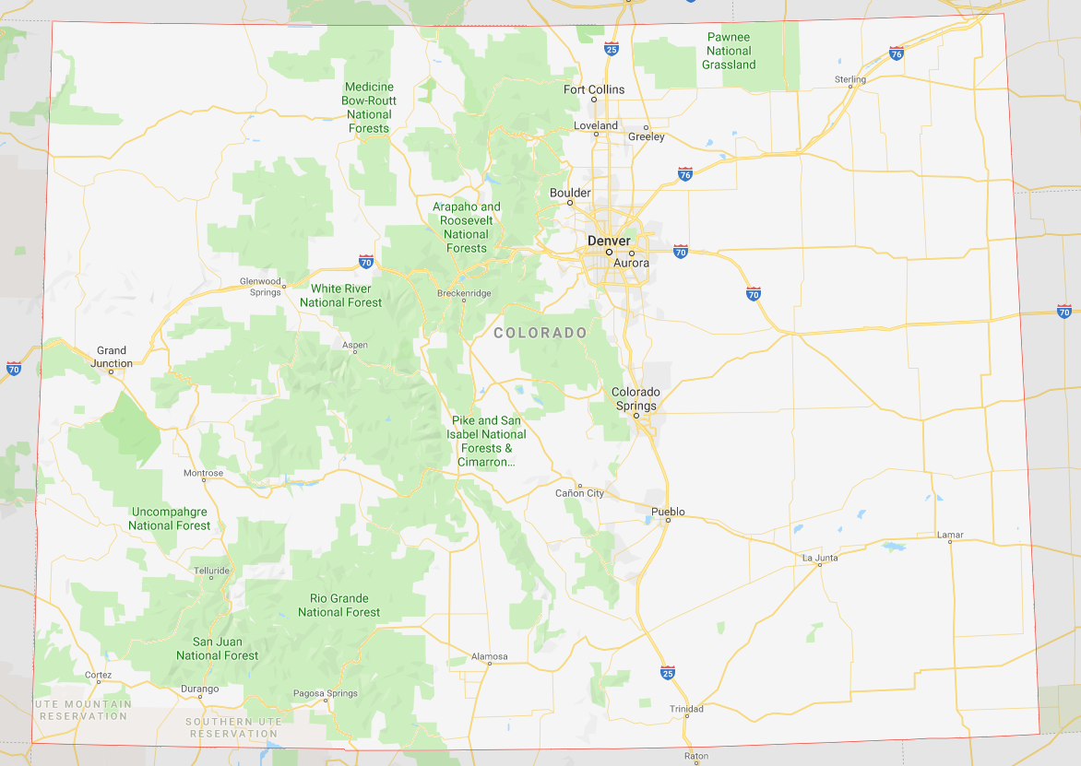
StateFocus
Notes:
Colorado’s first statewide model, an ABM.
It was based on the DRCOG ABM structure and estimated using 2010 survey data.
Unique modeling of closed/non-closed tours
Taxi use, let alone TNC use, was pretty non-existent in 2010.
CAV’s, of course, were a pipe dream.
But, now, these mode options are important for planning purposes…even though not a lot is known yet about how people will respond.

Slide 3
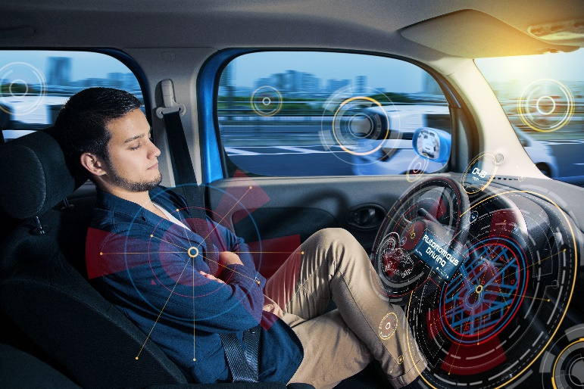
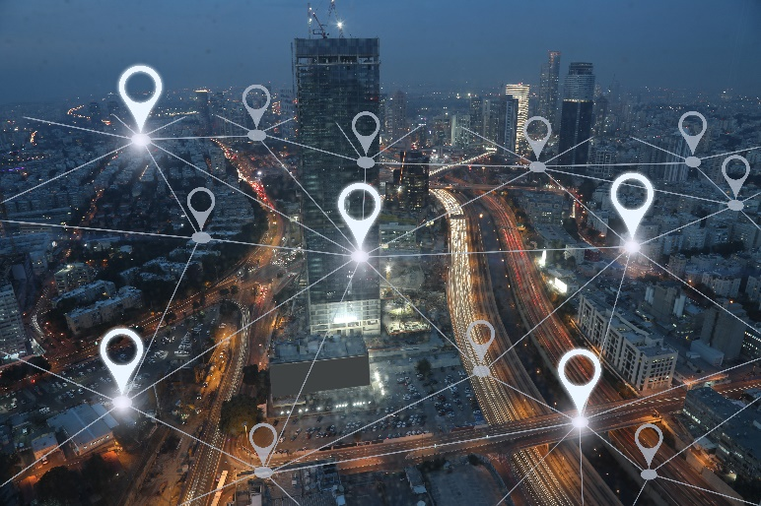
Features of AVs
Notes:
We are assuming new vehicle technology (AVs) would result in the following:
Capable of operating without a driver
Better ride experience (can safely eat, sleep, text, work, etc)
Vehicles can be sent home to make trips for other household members while the first “driver” is at an activity
More options for mobility-limited populations (older and younger persons)
Increased effective roadway capacity -> translates in ABM to potential changes in roadway capacity / freeflow speeds; furthermore, added AV-only facility type to test impacts of AV-only dedicated guideway
Now we consider how these things might impact how we travel….and how can those things be incorporated in an ABM

Slide 4
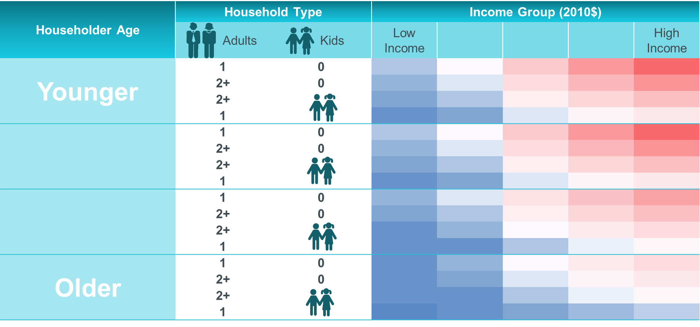
Functionalities
AV Household Simulation
Long-term Decisions
Tour Generation
Tour/Trip Level Choices
Assignment/ Skimming
Identifies households with AVs
Monte Carlo simulation
All or nothing
AV Vehicle Equivalency Factor
Escorting
Neutralize age-specific parameters
Sensitivity to IVTT
TNC Mode
Roadway capacities
Free flow speeds
AV-only facilities
Parking costs
Terminal times
New Component
No Changes-Indirect Impacts Only
Changes for AV/Non-AV
Notes:
AVs can be privately-owned or Mobility-as-a-Service (Maas)
For CAV Household Simulation:
Identifies households with AVs if auto availability model forecasts 1+ autos
All or nothing
Monte Carlo simulation to match assumed AV adoption rates
by households
by area type
Not a choice model
Based on available literature on technology adoption and information about households in the synthetic population, we decided that the likelihood of a household owning an AV would vary by income, household type, and age.
Relative probabilities for these categories
Sampling rates are these probabilities scaled to achieve target adoption rates by area type that input into the process

Slide 5
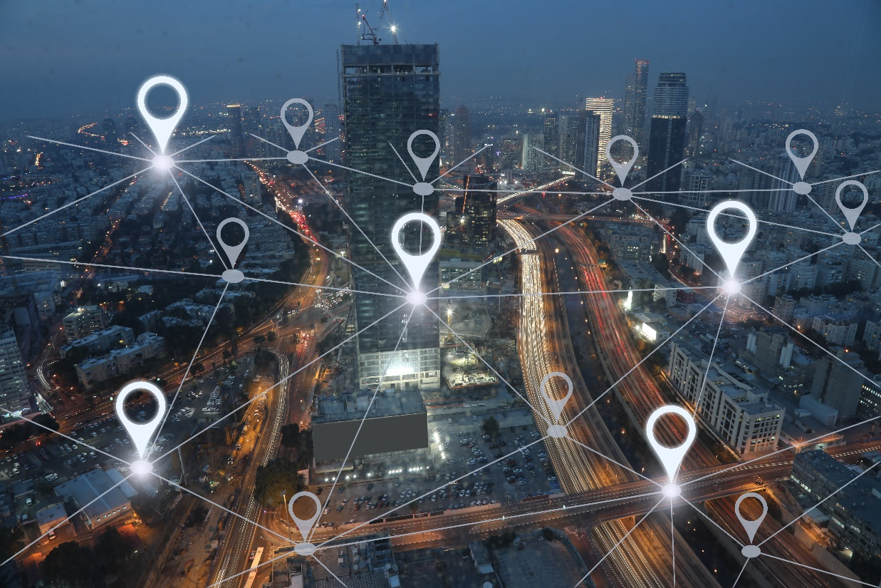
Functionalities
AV Household Simulation
Long-term Decisions
Tour Generation
Tour/Trip Level Choices
Assignment/ Skimming
Identifies households with AVs
Monte Carlo simulation
All or nothing
AV Vehicle Equivalency Factor
Escorting
Neutralize age-specific parameters
Sensitivity to IVTT
TNC Mode
Roadway capacities
Free flow speeds
AV-only facilities
Parking costs
Terminal times
New Component
No Changes-Indirect Impacts Only
Changes for AV/Non-AV
Notes:
AVs will not affect a persons’ workplace or school location choice
Vehicles can be sent home to make trips for other household members while the first “driver” is at an activity -> translates in ABM to AV vehicle equivalency factor

Slide 6
Functionalities
AV Household Simulation
Long-term Decisions
Tour Generation
Tour/Trip Level Choices
Assignment/ Skimming
Identifies households with AVs
Monte Carlo simulation
All or nothing
AV Vehicle Equivalency Factor
Escorting
Neutralize age-specific parameters
Sensitivity to IVTT
TNC Mode
Roadway capacities
Free flow speeds
AV-only facilities
Parking costs
Terminal times
New Component
No Changes-Indirect Impacts Only
Changes for AV/Non-AV
Notes:
More options for mobility-limited populations (older and younger persons) -> translates in ABM to changes in daily activity patterns, age has less significance and fewer escorting trips

Slide 7
Functionalities
AV Household Simulation
Long-term Decisions
Tour Generation
Tour/Trip Level Choices
Assignment/ Skimming
Identifies households with AVs
Monte Carlo simulation
All or nothing
AV Vehicle Equivalency Factor
Escorting
Neutralize age-specific parameters
Sensitivity to IVTT
TNC Mode
Roadway capacities
Free flow speeds
AV-only facilities
Parking costs
Terminal times
New Component
No Changes-Indirect Impacts Only
Changes for AV/Non-AV
Notes:
Better ride experience (can safely eat, sleep, text, work, etc) -> translates in ABM to decreased sensitivity to in-vehicle time and distance

Slide 8
Functionalities
AV Household Simulation
Long-term Decisions
Tour Generation
Tour/Trip Level Choices
Assignment/ Skimming
Tour Mode Choice
Auto (privately owned)
TNC (MaaS)
Walk to Transit
Drive to Transit
Drive/Ride Alone
Shared Ride 2
Shared Ride 3+
Ride Alone
Shared Ride 2
Shared Ride 3+
Walk
Bike
Identifies households with AVs
Monte Carlo simulation
All or nothing
AV Vehicle Equivalency Factor
Escorting
Neutralize age-specific parameters
Sensitivity to IVTT
TNC Mode
Roadway capacities
Free flow speeds
AV-only facilities
Parking costs
Terminal times
New Component
No Changes-Indirect Impacts Only
Changes for AV/Non-AV
Notes:
TNCs/MaaS are all AV (or none)

Slide 9
Functionalities
AV Household Simulation
Long-term Decisions
Tour Generation
Tour/Trip Level Choices
Assignment/ Skimming
Identifies households with AVs
Monte Carlo simulation
All or nothing
AV Vehicle Equivalency Factor
Escorting
Neutralize age-specific parameters
Sensitivity to IVTT
TNC Mode
Roadway capacities
Free flow speeds
AV-only facilities
Terminal times
Parking costs
New Component
No Changes-Indirect Impacts Only
Changes for AV/Non-AV
Notes:
Increased effective roadway capacity -> translates in ABM to potential changes in roadway capacity / freeflow speeds; furthermore, added AV-only facility type to test impacts of AV-only dedicated guideway.
These elements were then implemented in a flexible way, meaning all of these new functionalities can vary as we learn more about AVs and expected travel response.
To provide some more details about some of these new elements…

Slide 10
TNC / MaaS Calibration
Inputs
Implementation in Tour Mode Choice
Costs: flat fare plus distance-based cost
Initial Wait: varies by area type
Travel times and tolls: auto skims
Travel times and cost
Auto availability
Household Income
Time of Day (leave activity in the evening)
Tour Purpose (social/recreation)
NHTS data for overall mode share
Published studies on TNC users and trips
Calibration Data
Notes:
Taxi use, let alone TNC use, was pretty non-existent in 2010 but now have significant impacts on the transportation environment.
Given the low sample size, re-estimation was not an option.
However there was some data in the 2017 NHTS but still low sample size (7 weekday TNC trips for Colorado, 2,400 nationwide).
Used nationwide TNC data and data from other studies to determine characteristics of TNC users and trips.
Overall mode share of 0.28% for Colorado (nationwide was 0.47%).
Inputs – travel times from AV or non-AV skims

Slide 11
Vehicle Equivalency Factor
Adjust output of Auto Availability
Sensitivity Test Results
Directly affects the following model components:
Daily activity pattern
Exact number of tours
Tour and trip mode choice
Sensitivity test: AV Equivalency Factor = 2.0
Assignment
VMT | + 249k | + 0.7%
Notes:
Behavior-related: Vehicles can be used by multiple people throughout the day
For auto sufficiency variables, the AV vehicle equivalency factor is applied to households with vehicles until auto sufficiency is reached, then it has no impact.
Not much impact, likely due to auto sufficiency of households throughout Colorado. Mainly takes away from walk/bike trips.

Slide 12
Persons Under 16 Can “Drive”
Set minimum age of a “driver”
Sensitivity Test Results
Directly affects the following model components:
Tour and trip mode choice
Sensitivity test: Minimum “drive” age = 11
Assignment
VMT | + 546k | + 1.6%
Notes:
Biggest changes in mode shift for school tours, then social/rec
Overall mode shift is 1.9% increase in Drive Alone tours.

Slide 13
Sensitivity to IVTT
Reduce sensitivity to IVTT
Sensitivity Test Results
Directly affects the following model components:
Tour Mode Choice
Sensitivity tests -75% reduction
Notes:
Big reduction in sensitivity to in-vehicle time
Average length of closed tours increases by 15%; similar across all tour purposes

Slide 14
Sensitivity to IVTT, cont.
Sensitivity Test Results
Assignment
VMT | + 12.7 million | + 36%
Notes:
Non-closed tours increase by 183%, almost doubled.
Intuitively makes sense
Impacts on other models:
Overall increase in drive alone tours
Increase in number of intermediate stops on tours (0.3% for closed tours, 6.3% for non-closed tours)
Increases in average distance for intermediate stop locations (47% for CTs, 122% for NCTs)

Slide 15
Conclusions
Connected ABM elements to technology and behavioral responses
Focused on functionality and flexibility
Input AV adoption rates into the model
Evaluated short- and long-distance AV travel

Slide 16
Thank you mbina@camsys.com

